Slide 1
NDA workshop Vemurafenib (Zelboraf, Roche)
IND: 2006-09-01| NDA Submission: 2011-04-28 | NDA Approval: 2011-08-17
Sungpil Han
Dept. of Clinical Pharmacology & Therapeutics
Asan Medical Center
2018-03-02
Notes:
https://www.accessdata.fda.gov/drugsatfda_docs/nda/2011/202429s000TOC.cfm

Slide 2
Table of Contents
Introduction
Review: CMC
Review: Clinical Pharmacology
Review: Medical Review
Companion Diagnostics
Discussion

Slide 3
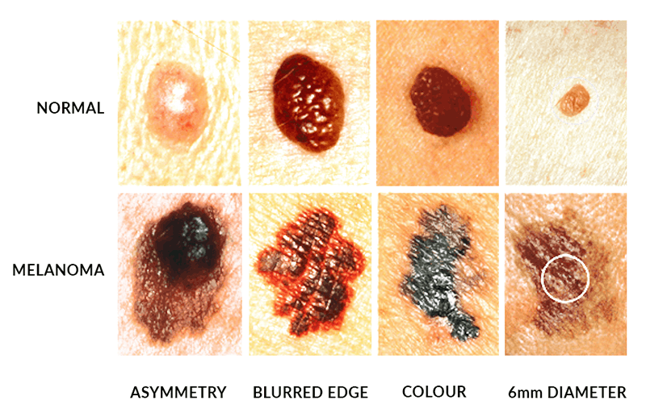
Introduction - Melanoma
Melanoma
5th leading cancer type in men
7th leading cancer type in women
estimated total of 76,100 new cases
9,700 deaths due to melanoma in 2014
Prognosis of metastatic melanoma
Median survival of approximately 6 months

Slide 4
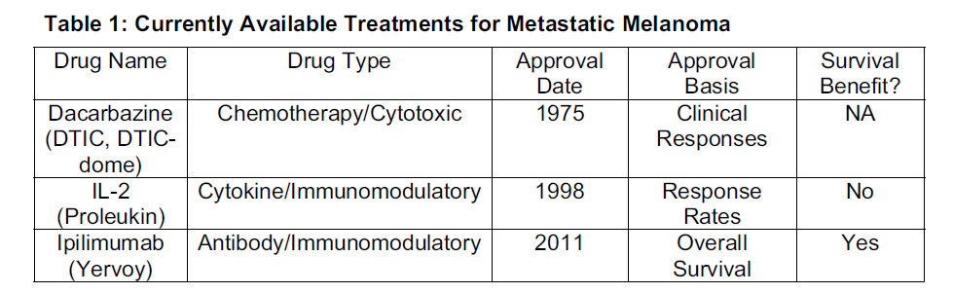
Introduction
3 drugs were approved by the FDA for the treatment of advanced melanoma.
Dacarbazine was approved over 30 years ago
no survival benefit has been demonstrated.
response rates with single-agent dacarbazine: 7% to 32%
OS: 5.6 to 11 months
Aldesleukin (IL-2) approval in 1998
A meta-analysis of chemoimmunotherapy versus chemotherapy found increased response rates and toxicity with chemoimmunotherapy
no improvement in survival

Slide 5
Introduction
Ipilimumab
monoclonal antibody targeting CTLA-4
approved in 2011
Median OS
ipilimumab–dacarbazine group : 11.2 months
dacarbazine group : 9.1 months
HR, 0.72 (95% CI, 0.59–0.87)

Slide 6
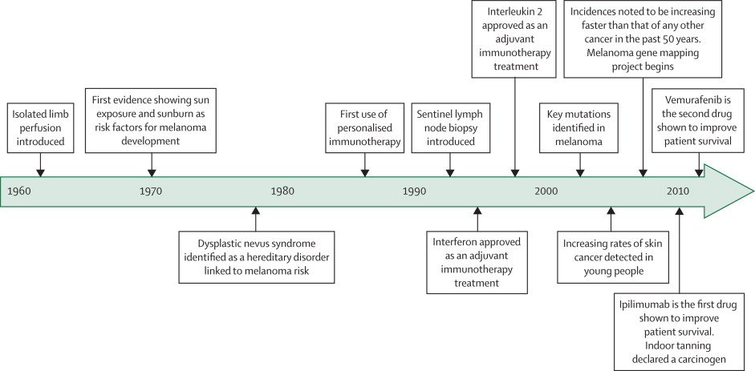
Timeline highlighting key events of the treatment of melanoma
Bombeli, Lancet, 2014
Notes:
Timeline highlighting key events since the 1960s that have directly affected the prevention and treatment of melanoma
Based on information made available from the American Society of Clinical Oncology.

Slide 7
Introduction
Somatic mutations in BRAF
increased activity of BRAF kinase
ERK activation and aberrant and uncontrolled cell proliferation and survival
In a prospective series of 308 patients with metastatic melanoma,
46% had a BRAF mutation
73% were V600E, 19% were V600K, and 6% were other.

Slide 8
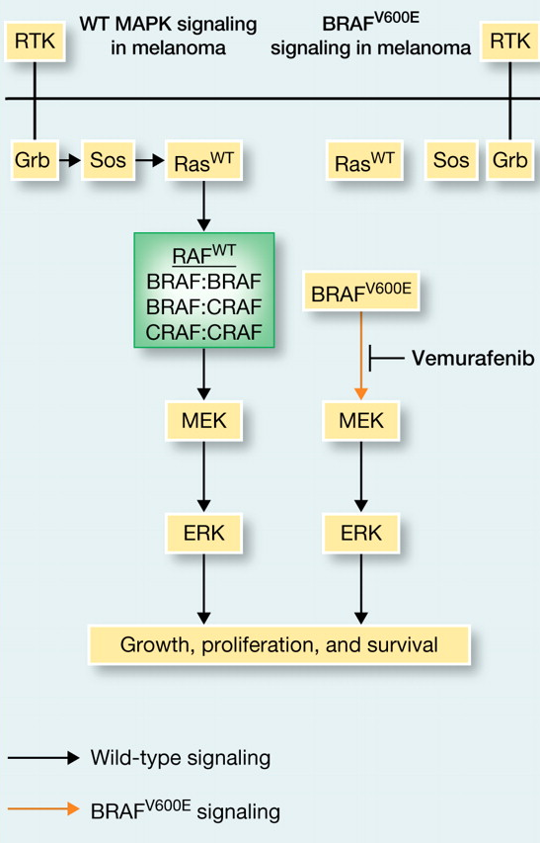
Introduction
Vemurafenib
Synthesized in 2005
BRAF_{V600E}: Selective binding to active form
Vemurafenib vs MEK inhibitor
Both: inhibition of cell proliferation
MEK inhibitor: inhibition of ERK phosphorylation in all cellular genotypes
Vemurafenib: ERK-phosphorylation only in BRAF-mutant cells
RAF inhibitor paradox
Paradoxical ERK phosphorylation induced by vemurafenib in WT BRAF cell

Slide 9
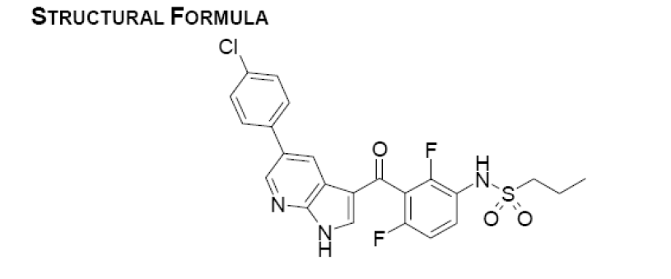
Introduction
PLX4032 or Vemurafenib (V600E mutant Raf inhibitor)
Initially developed by Plexicon and later Genentech
Zelboraf (vemurafenib) Tablet, 240 mg
for the treatment of unresectable or metastatic melanoma with the BRAFV600 mutation as detected by an FDA approved test

Slide 10
Introduction – Development Overview
Works well in vitro and in lab animals
Clinical trails begun 2008
Enrolled only patients with BRAF_{V600E}
Phase I: 16 patients with stage IV cancers
Median survival increased 9 → 15 months
Phase II: 132 patients with stage IV cancers
53% of patients responded. Similar increase in survival
Phase III: 675 patients with stage III or IV cancers
compared vemurafenib to dacarbazine
Stopped early. Dacarbazine patients moved to vemurafenib
FDA approval August 2011

Slide 11
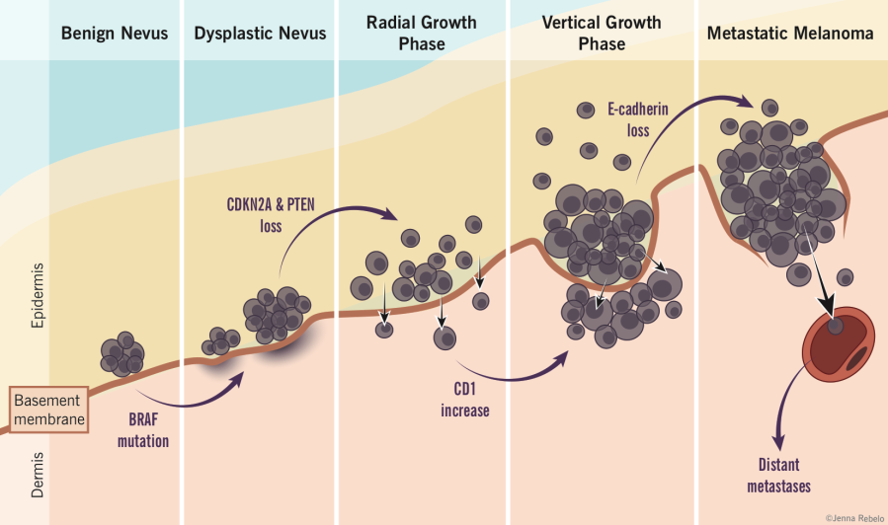
Introduction - Melanoma
Relapse rates
relatively high for late-stage disease
89% for stage IIIC
68% for stage IIIB
37% for stage IIIA
Stage IV has median survival of 9 months from diagnosis

Slide 12
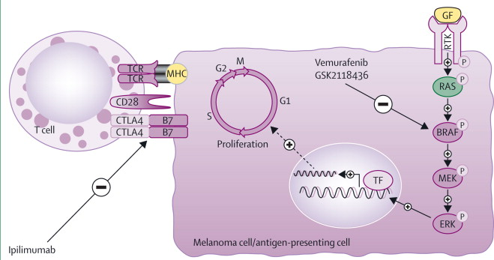
Mechanism of Action
Bombeli, Lancet, 2014
Notes:
http://www.thelancet.com/journals/lanonc/article/PIIS1470-2045(13)70333-4/fulltext
Figure 1
Present strategies to manage advanced stage melanomas include inhibition of the mutant form of BRAF kinase (a common mutation being BRAFV600E ; vemurafenib and GSK2118436) and T-cell activation (ipilimumab)
TCR=T-cell receptor. GF=growth factor. MHC=major histocompatibility complex. RTK=receptor tyrosine kinase. CTLA4=cytotoxic T lymphocyte antigen 4. TF=transcription factor.
View Large Image | View Hi-Res Image | Download PowerPoint Slide

Slide 13
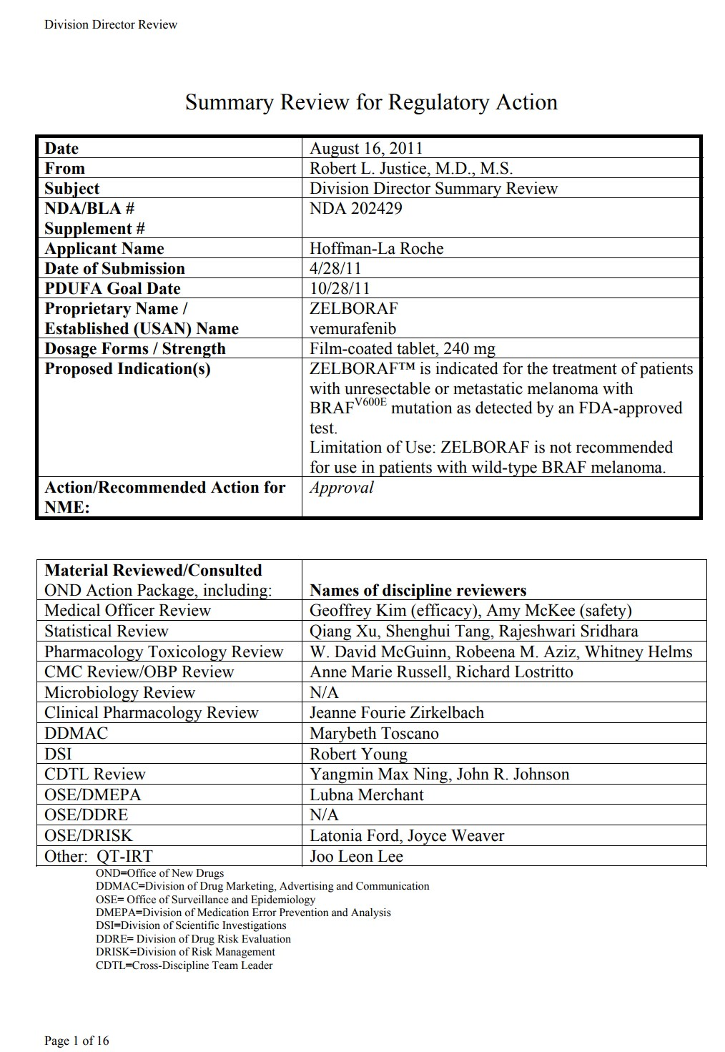
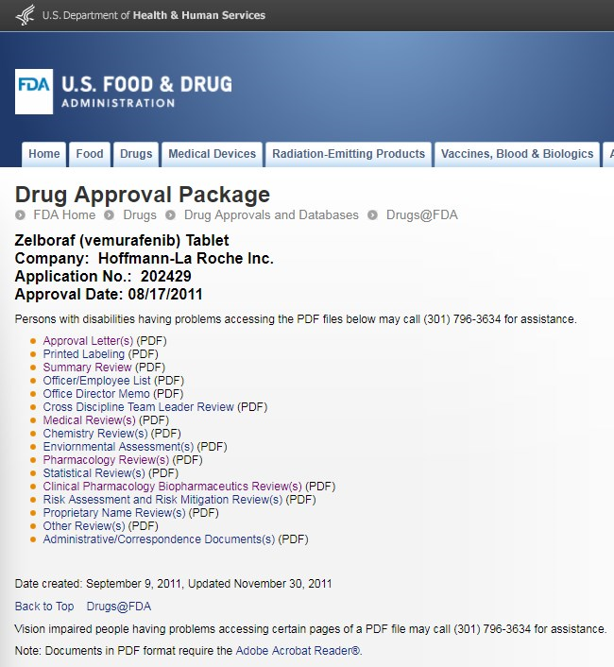
1st page of summary review (16 pages)

Slide 14
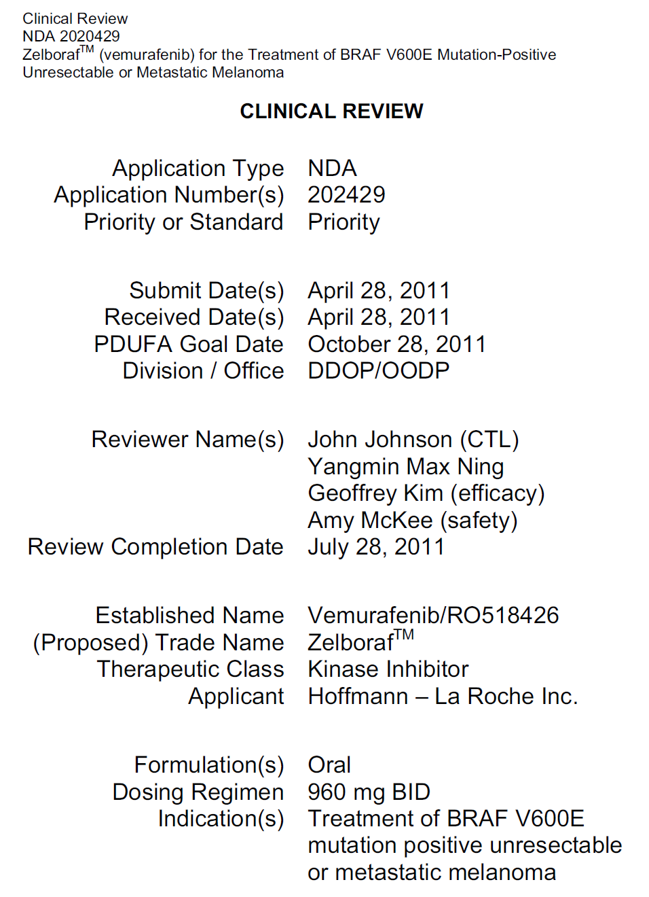
1st page of medical review (97 pages)
Priority review: 6 months (Standard review: 10 months)
Division of Drug Oncology Products/
Office of Oncology Drug Products
Clinical Review, NDA 2020429

Slide 15
Review: CMC (39 pages)
Chemistry, manufacturing, control

Slide 16
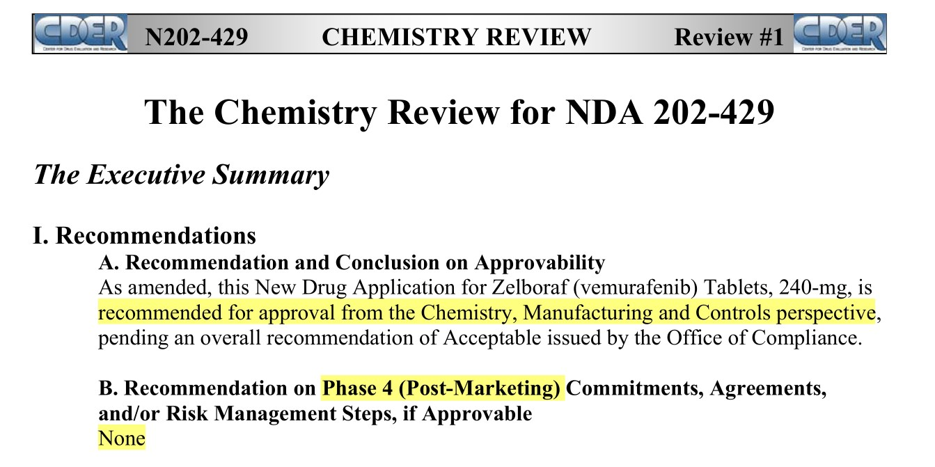
Chemistry

Slide 17
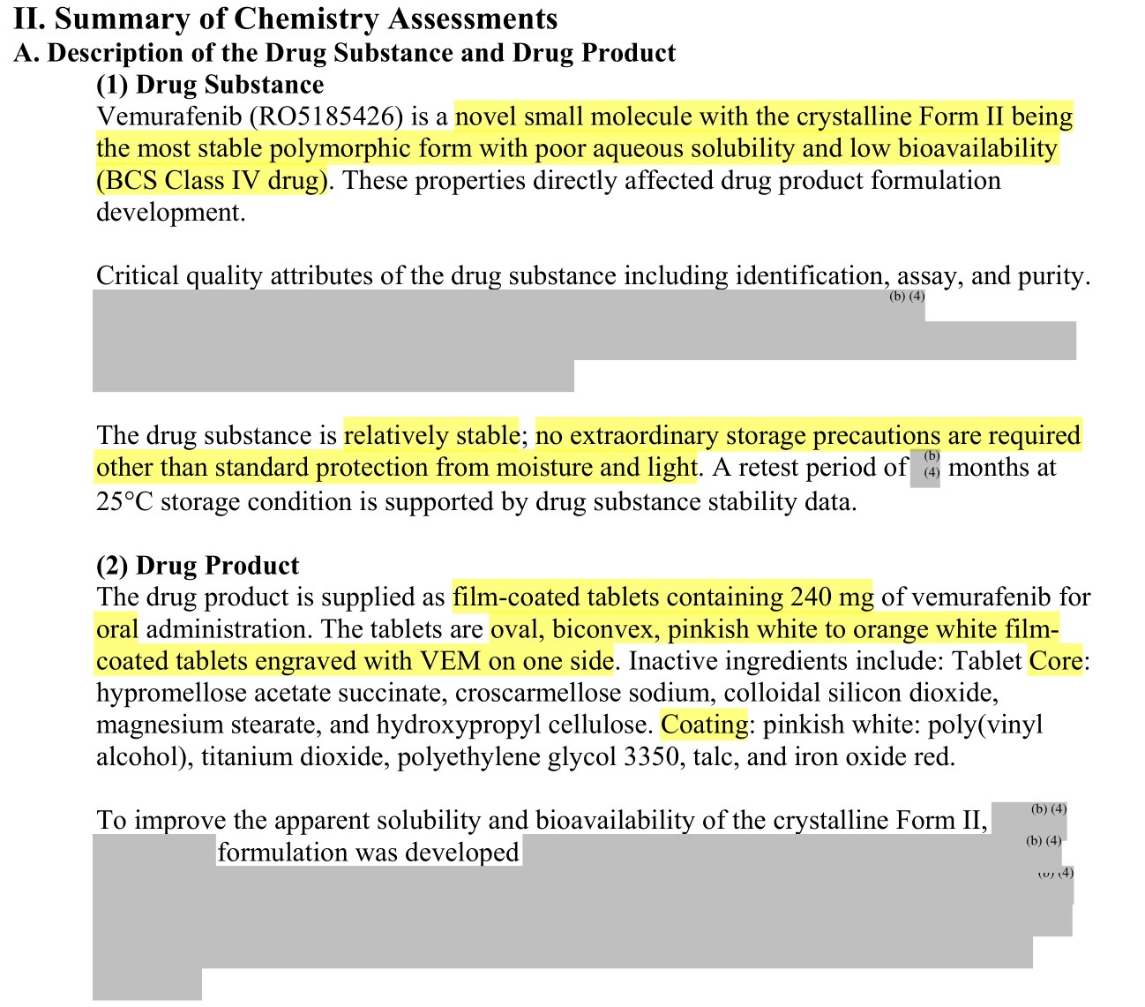

Slide 18
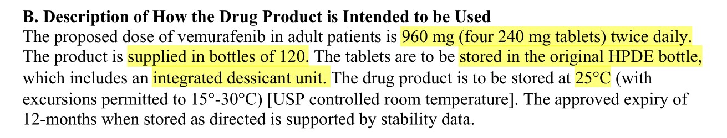

Slide 19
Review: Clinical Pharmacology (84 pages)
Chemistry, manufacturing, control

Slide 20
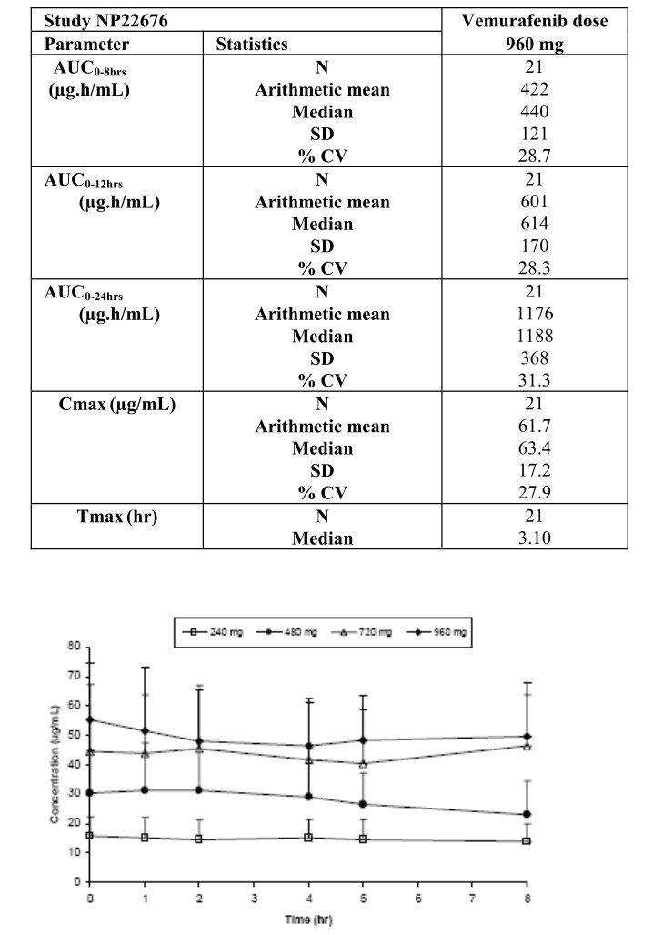
Clinical Pharmacology
Population PK
plasma concentration-time profile
one-compartment pharmacokinetic model
first-order absorption and first-order elimination.
PK at steady state
linear between 240 and 960 mg
Oral administration of 960 mg twice daily (for 15 days)
t_{max:} : ~ 3 hours
C_{max} :62 μg/mL ± 17
AUC0–12 : 601 ± 170 μg*h/mL.
FES: not been conducted
vemurafenib was administered without regard to food in the clinical trial.

Slide 21
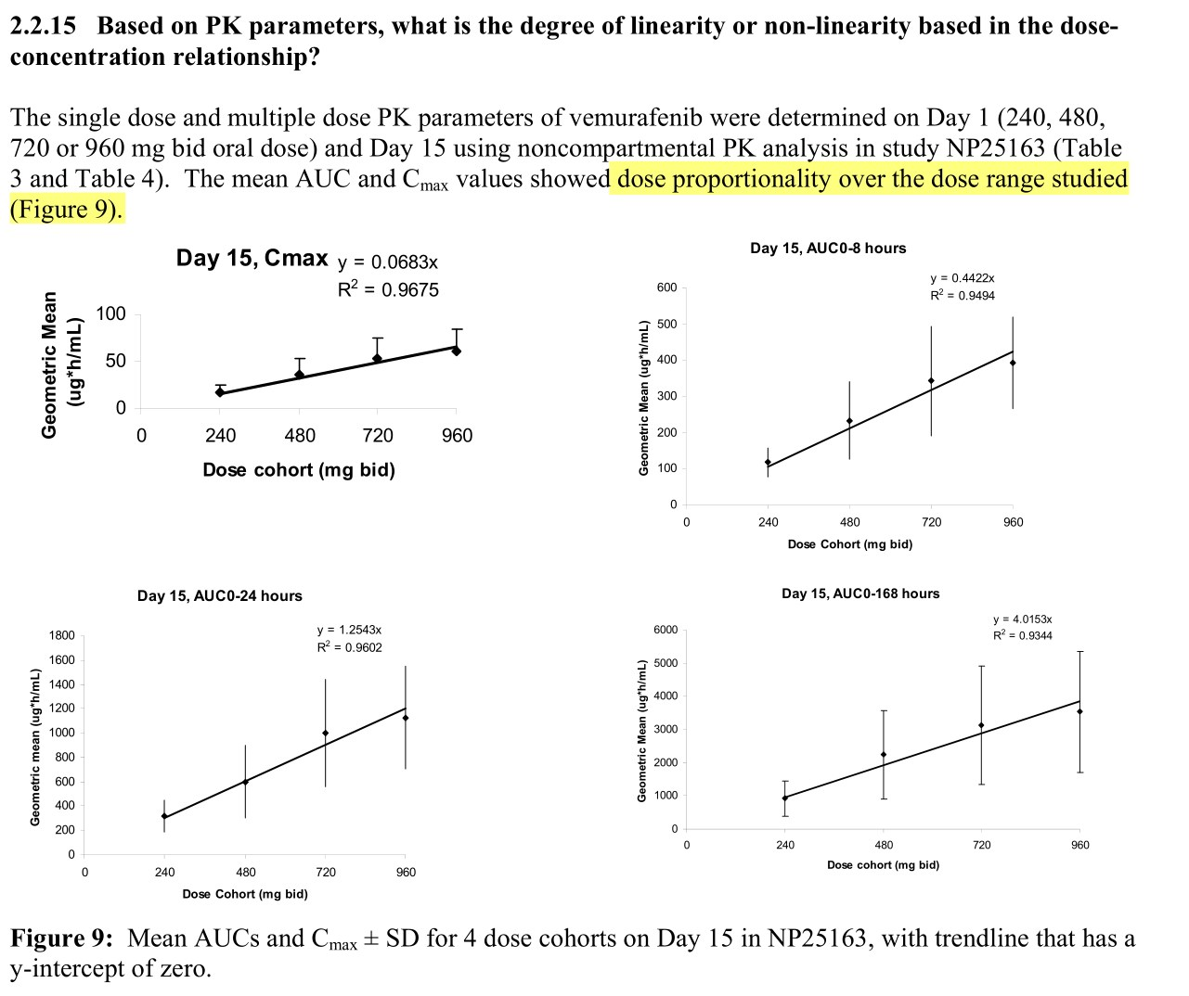

Slide 22
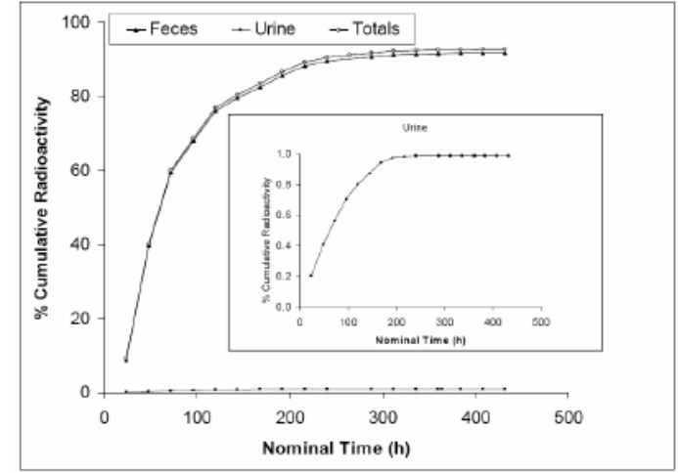
Clinical Pharmacology
Protein binding
highly bound (>99%) to human albumin and alpha-1 acid glycoprotein, and
Volume of distribution (V_{ss})
estimated to be 106 L.
Elimination
Excretion
mainly excreted in feces (94%)
Plasma clearance
31 L/day
Median elimination half-life
57 hours
¹⁴ C-vemurafenib

Slide 23
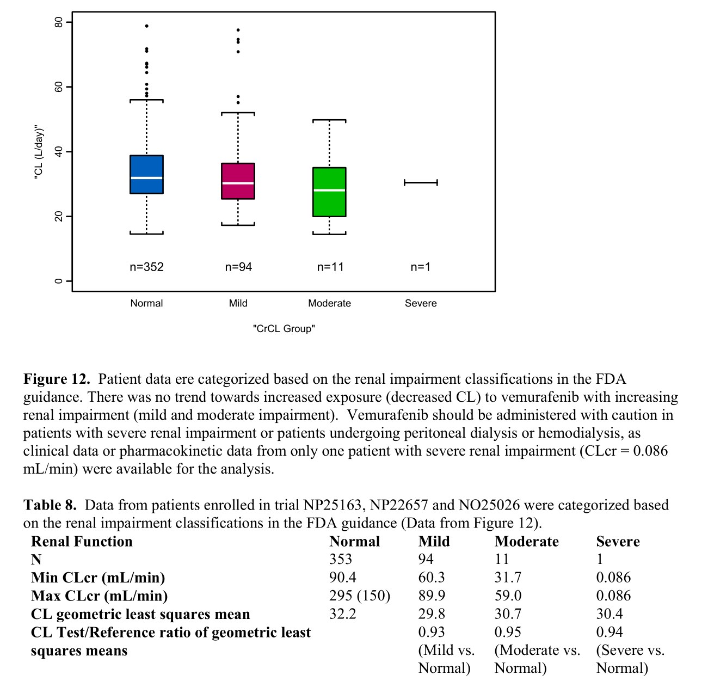

Slide 24
Clinical Pharmacology
Hepatic impairment
Vemurafenib clearance was similar in patients with normal, mild, and moderate hepatic impairment
“Therefore, dose adjustments are not needed for mild and moderate hepatic impairment.”
effect of severe hepatic impairment on vemurafenib exposure was unknown.
Drug Interaction
In vitro
substrate of CYP3A4 and
both a substrate and inhibitor of P-glycoprotein.

Slide 25
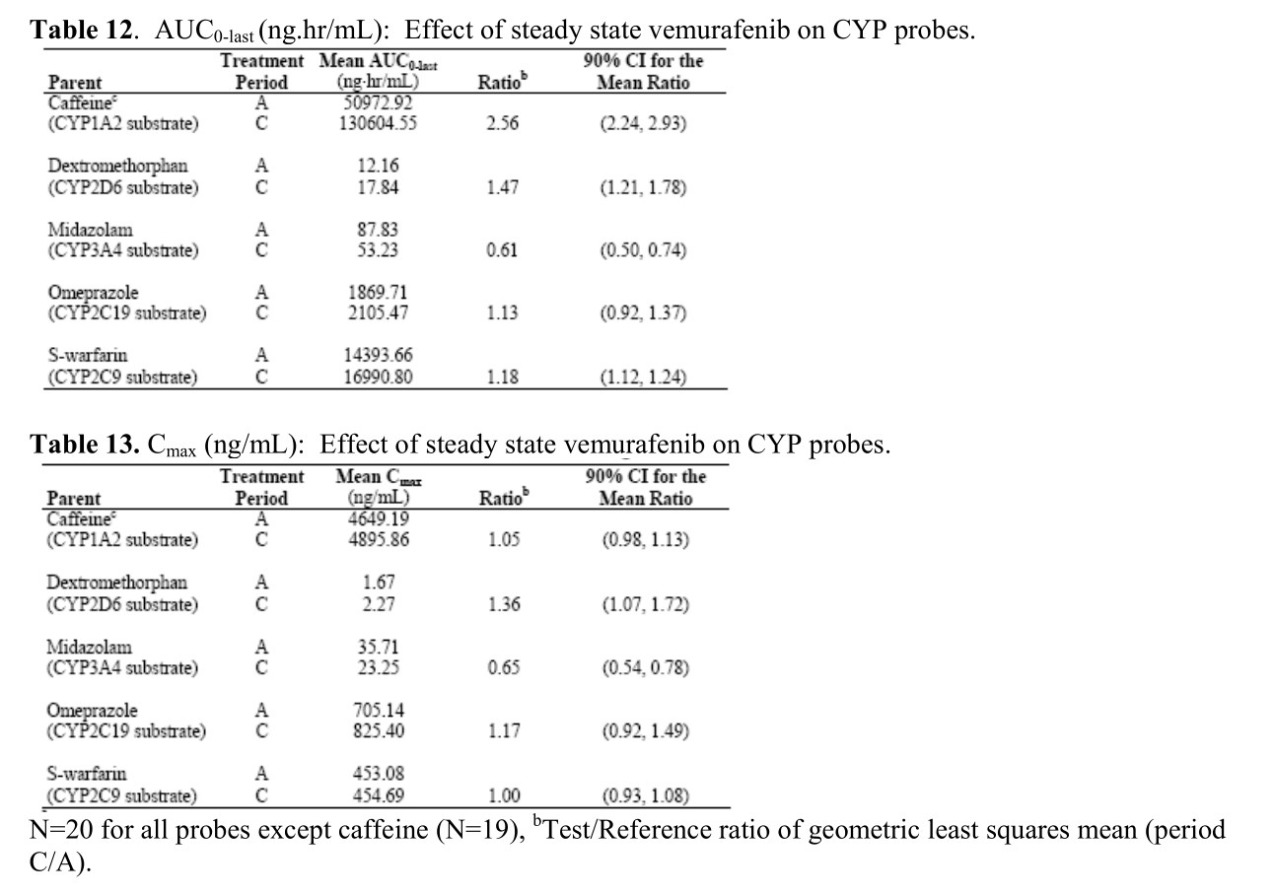
Effects on CYP enzyme
“cocktail approach” was used in trial NP22676 to investigate the potential drug-drug interactions
of vemurafenib with multiple CYP enzymes in patients with metastatic melanoma. The applicant used a combination of probe drugs known as the “Cooperstown 5+1 cocktail” in trial NP22676.
Clinical Pharmacology and Therapeutics. 2000 Oct;68(4):375-83.
In vivo
inducer of human CYP3A4
moderate inhibitor of CYP1A2
a weak inhibitor of CYP2D6

Slide 26
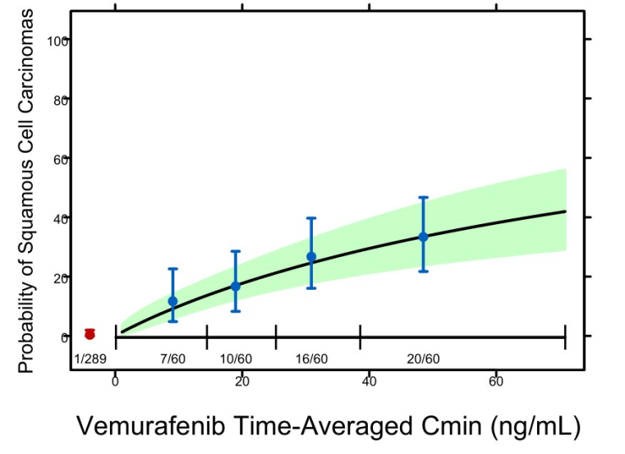
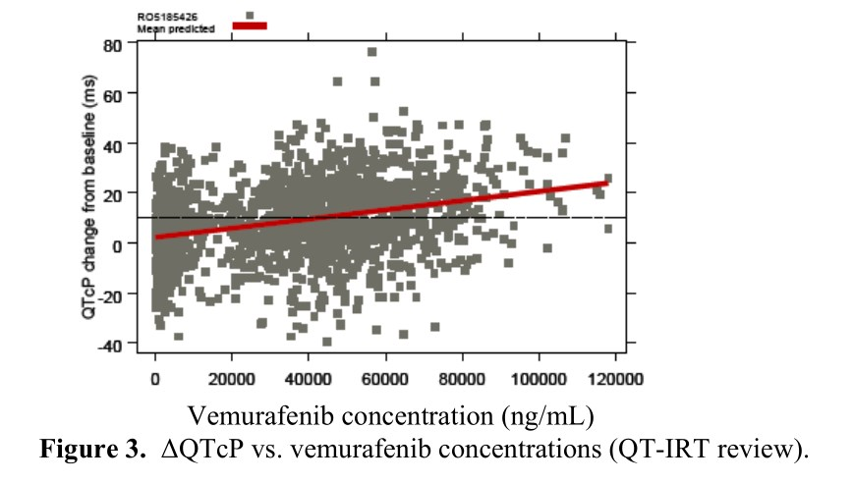
Clinical Pharmacology
significant exposure–response relationship
progression-free survival (PFS)
vemurafenib exposure (C_{min})
conclusive relationship between exposure and OS could not be demonstrated.
Significant exposure–response relationship
risk of cuSCC development and vemurafenib exposure (C_{min})
exposure–QTc response analysis
data from the phase II trial showed that following treatment with vemurafenib 960 mg twice daily
QTc interval was prolonged in a concentration-dependent manner
no large changes (i.e., >20 ms) in the mean QTc interval

Slide 27
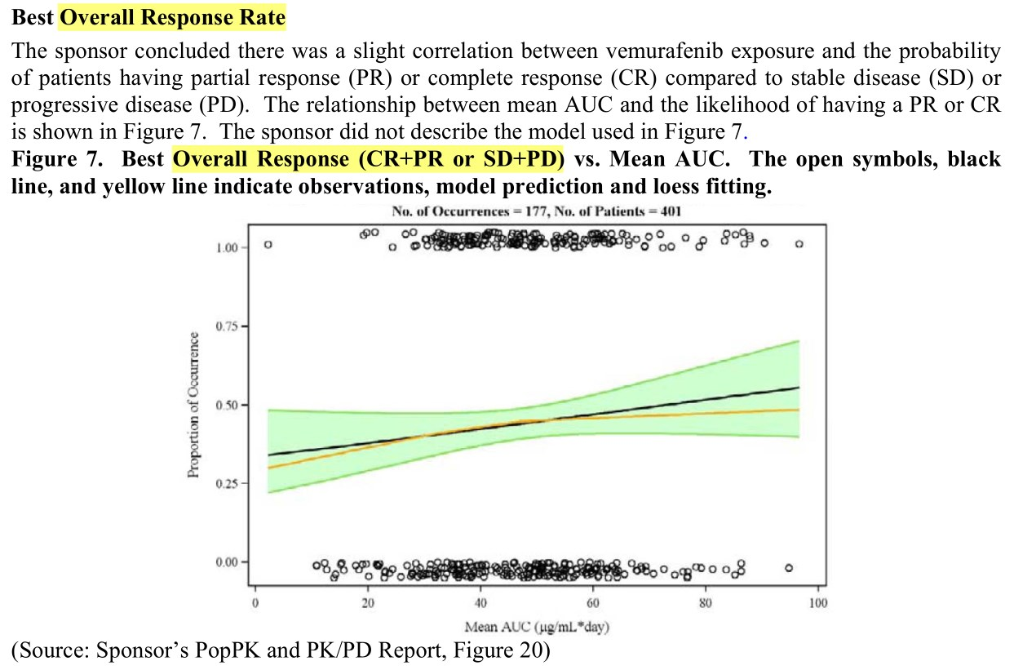

Slide 28
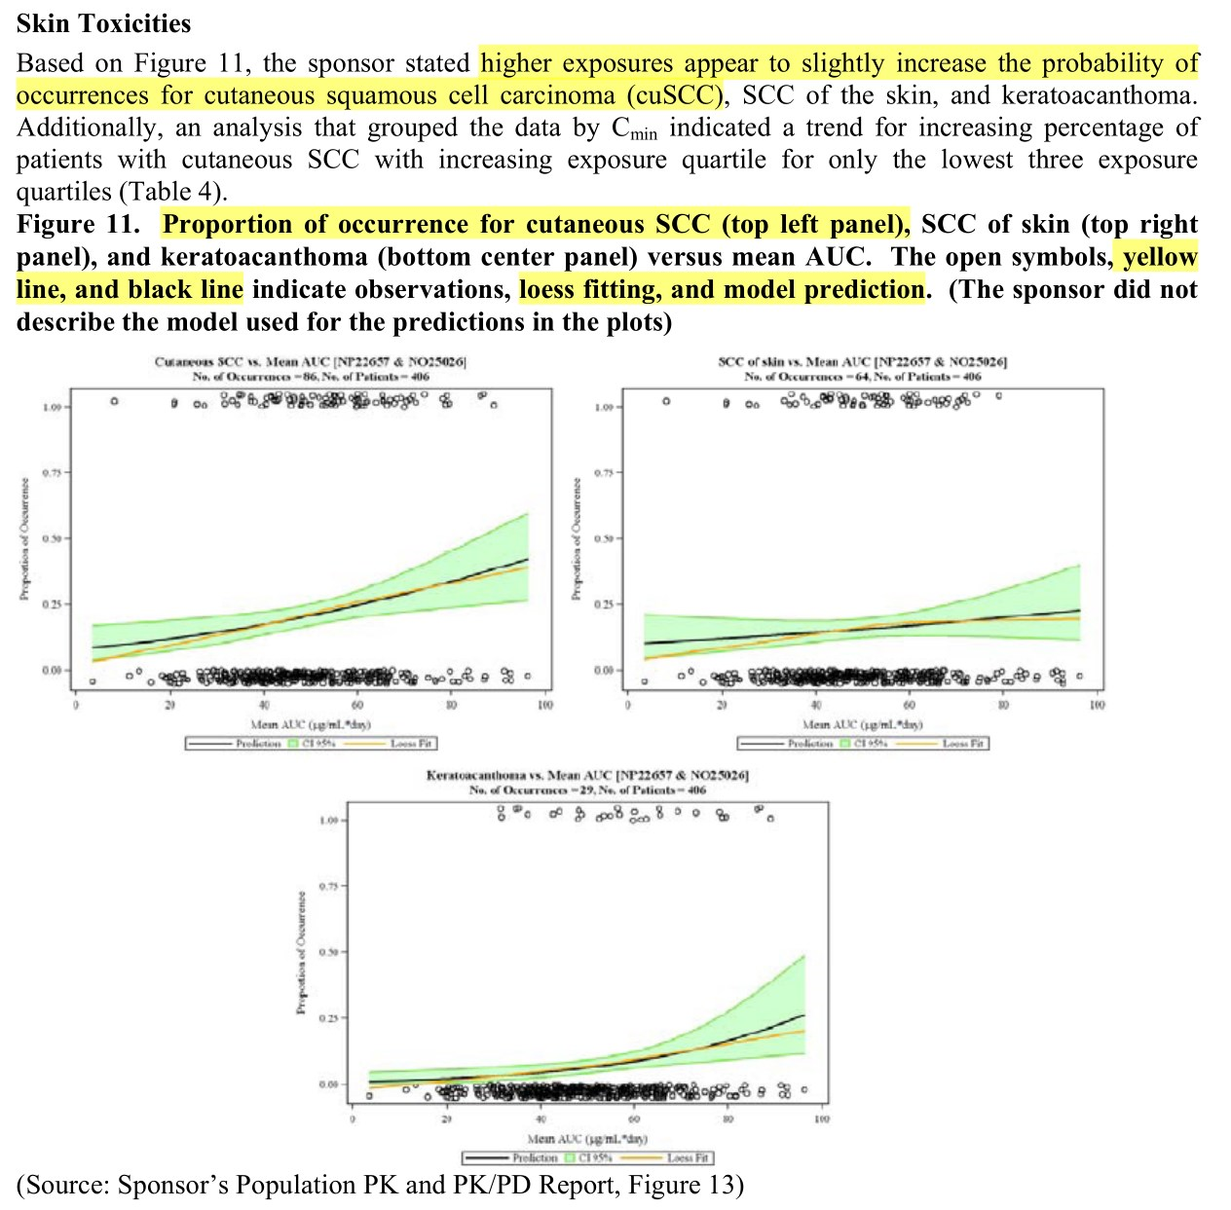

Slide 29
Review: Medical Review, Clinical Trials (105 pages)

Slide 30
IND (2006-09)
The IND named PLX4032
claimed as a selective inhibitor of BRAF kinase V600E mutant and intended to be investigated in patients with tumors containing the point mutation, including melanoma
The Phase 1 protocol was evaluated and found to be safe to proceed

Slide 31
Phase I Study (2007-2009)
Original formulation: poor bioavailability
Use of new formulations of PLX4032
Form of a microprecipitated bulk powder (MBP) drug polymer-matrix
to improve the bioavailability of PLX4032
Phase 1 study: New formulation could be started at 160 mg BID
The FDA evaluation of the safety data determined.
equivalent to the original formulation at 800 mg BID in terms of serum levels of the product.
determined MTD - 960 mg BID,
verified further in an expansion cohort of patients with metastatic melanoma positive for the BRAFV600E mutation.

Slide 32
End-of Phase 1 Meeting (2009-05)
Agency proposal to develop PLX4032
based on the encouraging tumor response results from 16 patients
The Agency recommendation
randomized Phase 3 trial with overall survival as the primary endpoint
no evidence showed that PFS is not an adequate surrogate endpoint in metastatic melanoma.
Initiate a comprehensive long term plan to monitor the safety of the product, including possible incidences of non-cutaneous squamous cell carcinomas.
development of a companion diagnostic to detect the BRAF V600E mutation during clinical trials

Slide 33
Fast Track Designation (2010-06)
The request for the Fast Track designation
Granted
on the basis that the product was being investigated to improve overall survival in patients

Slide 34
Expanded Access Program
Communication
for sponsors and the FDA to communicate and respond rapidly to important new information.
Phase I trial : publication of the unprecedented results / preliminary confirmation
Phase II trial : activity of vemurafenib confirmed
Phase III : BRIM-3
The FDA and the sponsor worked together quickly to amend the rapidly accruing BRIM-3 trial and to open an expanded access program.
동정적사용승인계획(同情的使用承認計劃, EAP - Expanded Access Program)은 불치병에 걸렸거나 암 말기인 환자가 적절한 치료제가 없어 치료를 포기할 상황에 이를 경우 의료당국이 시판승인 전의 신약을 무상으로 공급해 치료기회를 주는 제도를 말한다. 동정적사용프로그램이라고도 한다. (compassionate use)

Slide 35
BRIM3 (Vemurafenib Front-Line Trial – Phase III Study Design)
Screening
BRAF^{V600E} mutation
Stratification:
Stage
ECOG PS (0 vs 1)
LDH (elevated vs normal)
Geographic region
Vemurafenib
960 mg PO bid
(n = 337)
Randomization
n = 675
Dacarbazine
1000 mg/m² IV q3wk
(n = 338)
Co-primary endpoints were OS and PFS

Slide 36
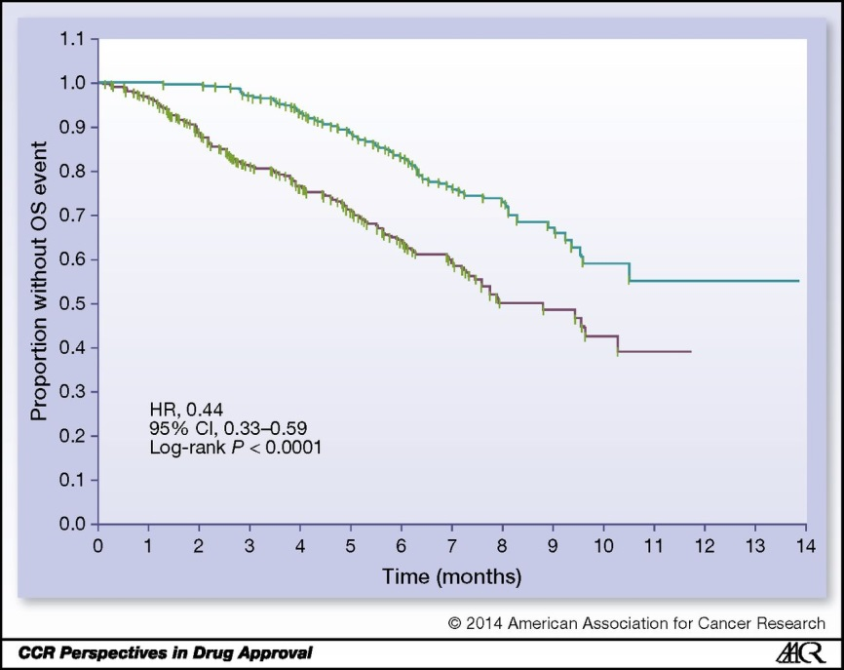
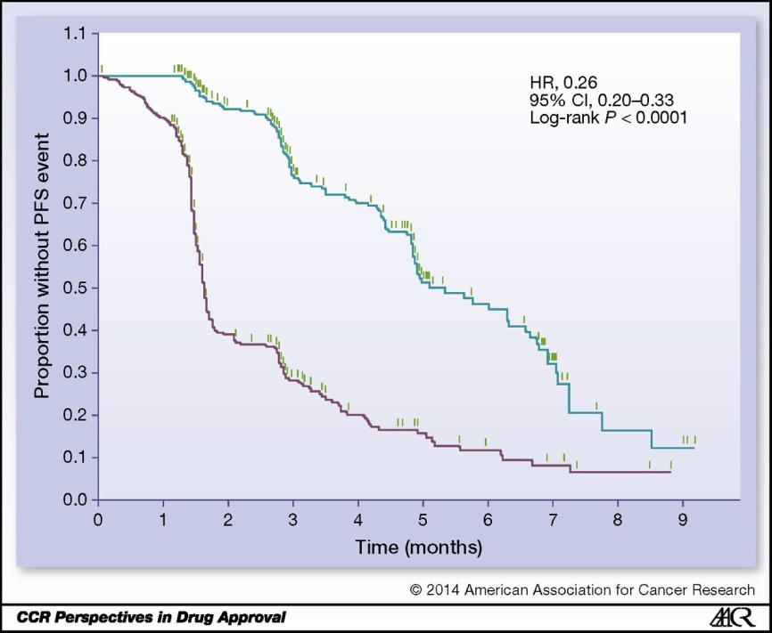
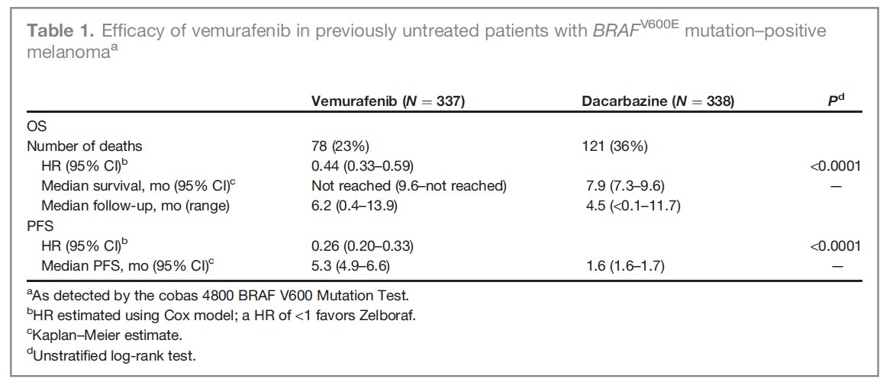
Efficacy – BRIM3
Overall Survival
Interim analysis of OS
HR: 0.37 (95% CI, 0.26–0.55; P < 0.001)
Updated OS analysis before approval
HR: 0.44 (95% CI, 0.33–0.59; P < 0.0001).
median OS
not been reached (NR) in the vemurafenib arm (95% CI, 9.6–NR)
7.9 months in the dacarbazine arm (95% CI, 7.3–9.6)

Slide 37
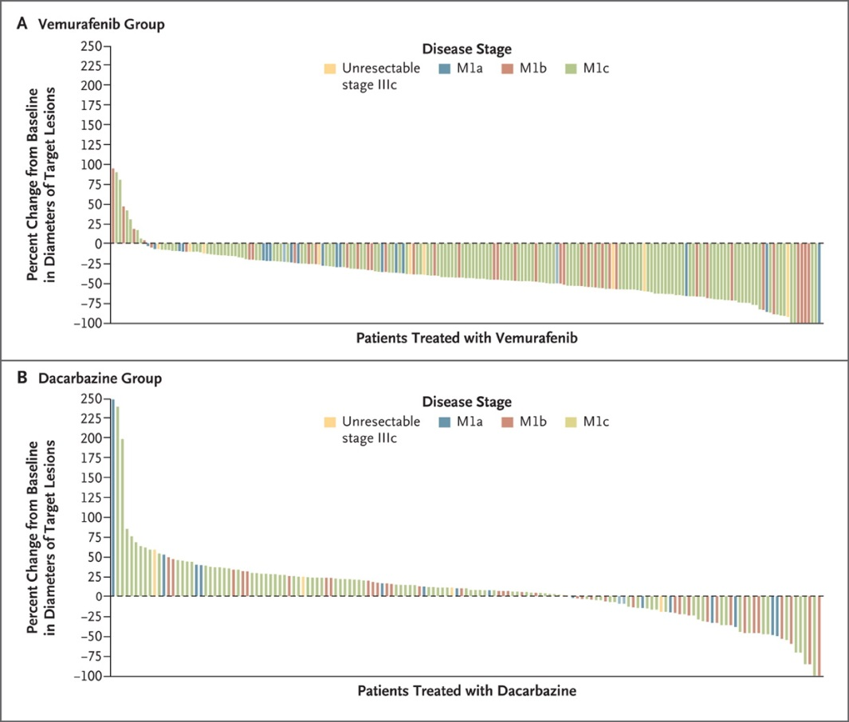
Efficacy - BRIM3
Confirmed, investigator-assessed best ORR rate
Vemurafenib: 48.4% (95% CI, 41.6%–55.2%) Dacarbazine: 5.5% (95% CI, 2.8%–9.3%)
Responses
Vemurafenib:
2 complete responses (0.9%)
104 partial responses (47.4%)
Dacarbazine:
12 partial responses (5.5%)
Chapman PB et al, Improved Survival with Vemurafenib in Melanoma with BRAF V600E Mutation, NEJM, 2011

Slide 38
Safety
The most common adverse reactions (≥30%)
arthralgia, rash, alopecia, fatigue, photosensitivity reaction, and nausea.
Cutaneous squamous cell carcinomas or keratoacanthomas
approximately 24% of patients
Other adverse reactions
hypersensitivity, Stevens-Johnson syndrome, toxic epidermal necrolysis, uveitis, QT prolongation, and liver enzyme laboratory abnormalities.

Slide 39
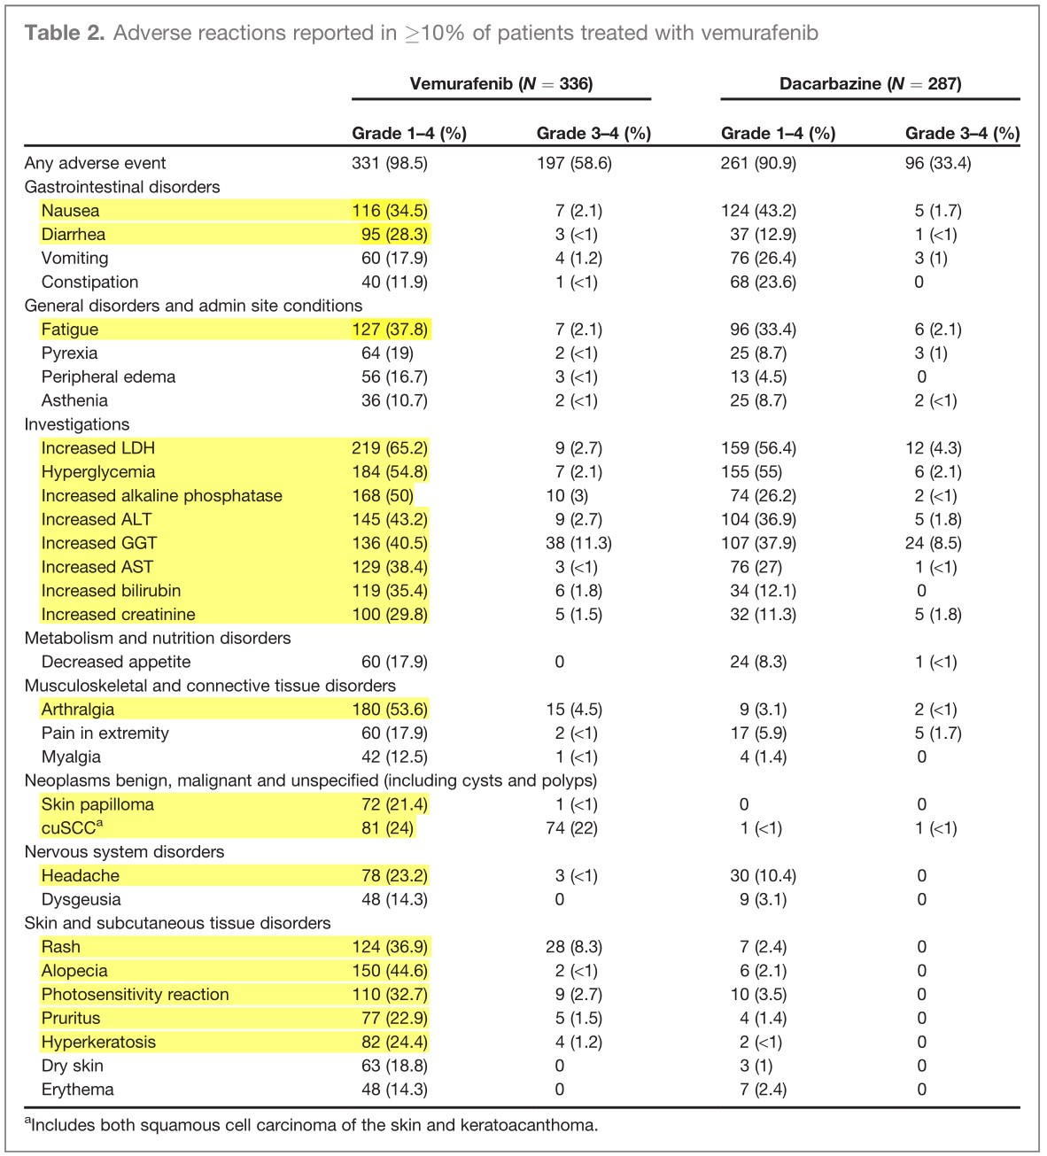

Slide 40
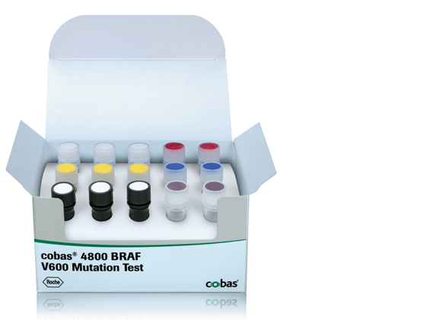
Companion Diagnostic for Vemurafenib
In vitro diagnostic: The cobas 4800 BRAF V600 Mutation Test
real-time PCR-based in vitro diagnostic
DNA from formalin-fixed, paraffin-embedded human melanoma tissue
Goal: selection of patients with BRAF^{V600E}-mutated melanoma for treatment with vemurafenib.
postmarketing commitment
develop an Investigational Use Only Companion Diagnostic (IUO CoDx) that reliably detects the BRAF^{V600K} mutation in tumors of patients with unresectable or metastatic melanoma
conduct an open-label, single-arm trial in a population identified by this test with ORR and duration of response as the primary endpoints.
Notes:
https://molecular.roche.com/assays/cobas-4800-braf-v600-mutation-test/
A companion diagnostic for vemurafenib
The cobas® 4800 BRAF V600 Mutation Test detects the BRAF V600E mutation in formalin-fixed, paraffin-embedded (FFPET) human melanoma tissue. It is designed to help select patients for treatment with vemurafenib, an oral medicine designed to treat patients whose melanoma tumors harbor a mutated form of the BRAF gene.
Features and Benefits
The cobas® BRAF Mutation Test was used in pivotal clinical trials for vemurafenib, to select patients whose tumors harbor the V600E mutation in the BRAF gene.
In pre-clinical and clinical investigations, the cobas® BRAF Mutation Test had 97.3% positive agreement in detecting the BRAF V600E (1799 T>A) mutation, which represents >~85% of all BRAF mutations reported in the COSMIC database.
The cobas® BRAF Mutation Test is more sensitive in the detection of V600E mutations than Sanger sequencing.*
In formalin-fixed, paraffin-embedded tissue (FFPET), the cobas® BRAF Mutation Test can detect V600E mutations at >5% mutation level.*
The test may also detect other V600 mutations such as V600D and V600K.*
The cobas® BRAF Mutation Test has a low failure rate and is highly reproducible across operators, reagent lots and testing days.*
The cobas® BRAF Mutation Test can be performed in <8 hours from receipt of specimen.
Liquid, ready-to-use reagents are provided in the test kit to increase laboratory efficiency.
The test kits have >12 months shelf life from date of manufacture and upon opening each reagent maintains open-vial stability for up to 90 days.

Slide 41
Discussion
No approved agents
Until 2011
survival benefit in advanced malignant melanoma.
1st personalized therapy for melanoma in which patients are selected using an analytically and clinically validated test.
The new drug application was approved less than 4 months after submission.

Slide 42
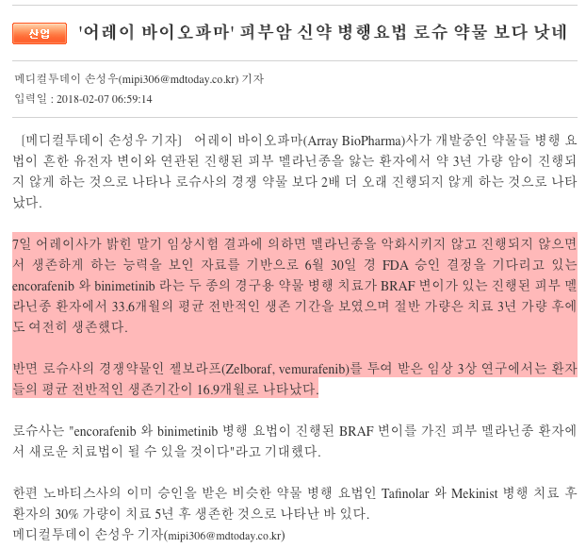


Slide 43
감사합니다.
References
FDA, CDER, 202429Orig1s000
Medical Reviews https://www.accessdata.fda.gov/drugsatfda_docs/nda/2011/202429Orig1s000MedR.pdf
Approval Package 202429Orig1s000 https://www.accessdata.fda.gov/drugsatfda_docs/nda/2011/202429Orig1s000Approv.pdf
Clinical Pharmacology https://www.accessdata.fda.gov/drugsatfda_docs/nda/2011/202429Orig1s000ClinPharmR.pdf
Pharmacology https://www.accessdata.fda.gov/drugsatfda_docs/nda/2011/202429Orig1s000PharmR.pdf

